Slide 1

Regionalism in Indian Politics
By:
Kangkana Sharma
Assistant Professor
Deptt. of Political Science
Dhing College

Slide 2
Regionalism: Meaning
Regionalism is an ideology and political movement that seeks to advance the causes of regions. As a process it plays role within the nation as well as outside the nation i.e. at international level. Both types of regionalism have different meaning and have positive as well as negative impact on society, polity, diplomacy, economy, security, culture, development, negotiations, etc.

Slide 3
Characterisitics of Regionalism:
Regionalism is conditioned by economic, social, political and cultural disparities.
Regionalism at times is a psychological phenomenon
Regionalism is built around as an expression of group identity as well as loyalty to the region
Regionalism presupposes the concept of development of one's own region without taking into consideration the interest of other regions
Regionalism prohibits people from other regions to be benefited by a particular region.

Slide 4
Regionalism: Historical Background
Roots of regionalism is in India’s manifold diversity of languages, cultures, ethnic groups, communities, religions and so on, and encouraged by the regional concentration of those identity markers, and fueled by a sense of regional deprivation.

Slide 5
Causes of Regionalism in India:
Geographical
Political
Linguistic and Cultural Aspirations
Economic
Historical

Slide 6
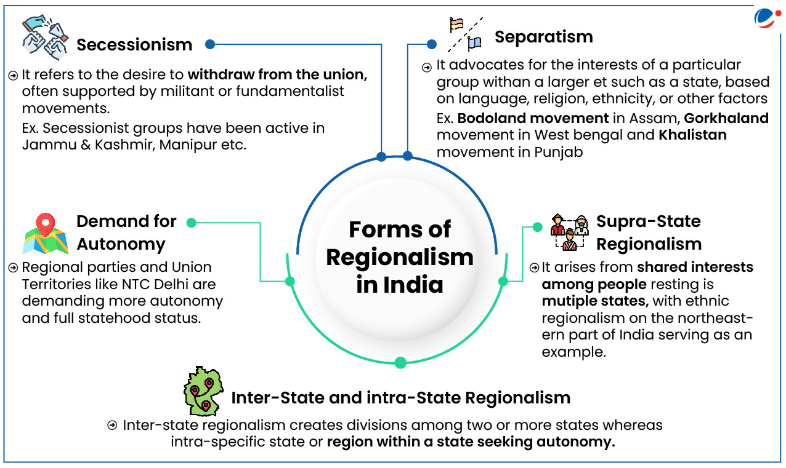

Slide 7
Impact of Regionalism in India:
Positive Impact
Scholars believe that regionalism plays important role in building of the nation, if the demands of the regions are accommodated by the political system of the country.
Negative Impact:
Regionalism is often seen as a serious threat to the development, progress and unity of the nation.

Slide 8
Suggestive Measures:
Doing away with regional imbalance
Developed means of transport and communication
Check on regional political parties
Top priority to the economic development of deprived zones
Proper education

Slide 9
Conclusion
There should be a greater spirit of accommodation on the part of the Central authorities.
They should be generous towards the minorities, religious, cultural and linguistic.

Slide 10
Thank you

